Slide 1
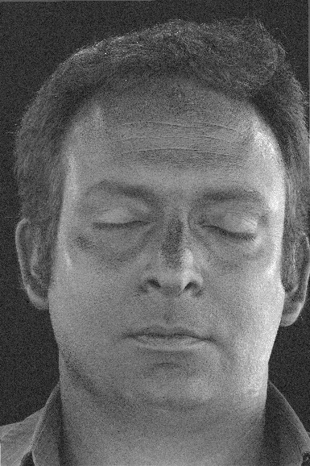
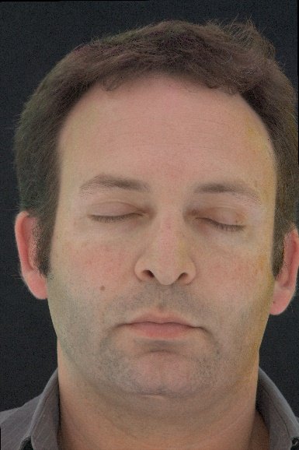
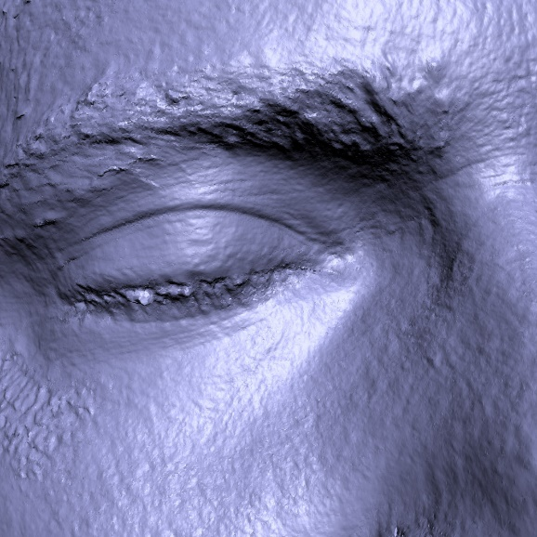
Single-Shot Reflectance Measurement from Polarized Color Gradient Illumination
Graham Fyffe Paul Debevec
USC Institute for Creative Technologies

Slide 2
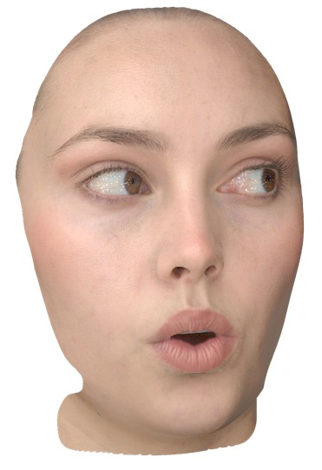
Measuring How Surfaces Reflect Light
Reflectance is important for realistic rendering of digital models.
diffuse albedo, specular albedo, normal
Traditionally requires photographs under multiple lighting conditions.
Single-shot methods do not capture much in the way of reflectance.
Digital Emily

Slide 3
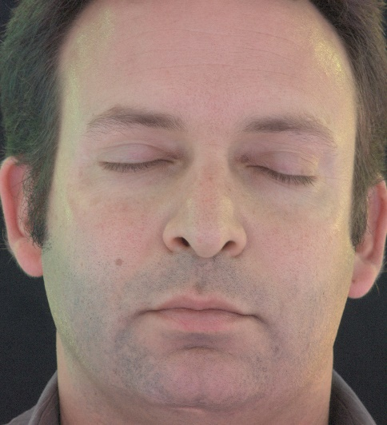
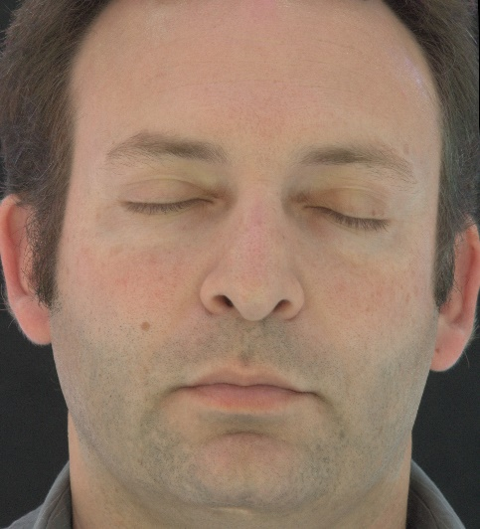
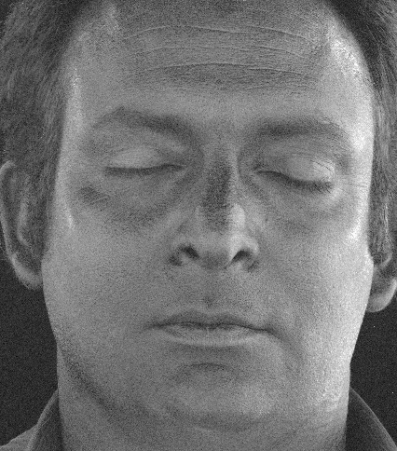
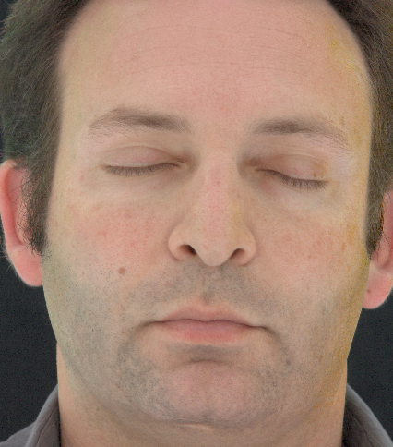
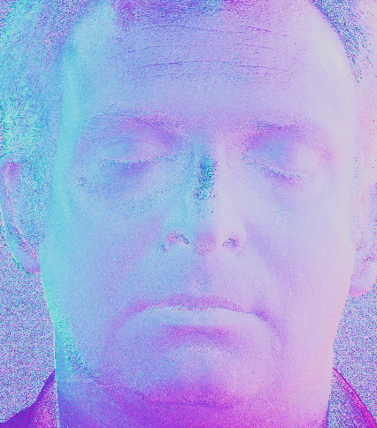
Overview of Method
Two photos, shot simultaneously using a beam splitter.
Compute diffuse albedo, specular albedo, and normal.
Alternate multi-view setup using linear polarizing filters.
two simultaneous photos
specular
diffuse
normal

Slide 4
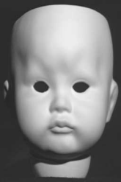
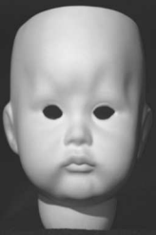
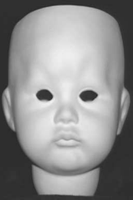
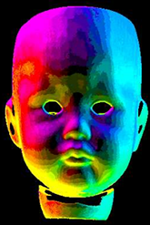
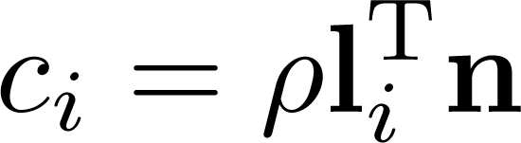



Photometric Stereo [Woodham1980]
Compute surface normals from 3 photographs.

Slide 5
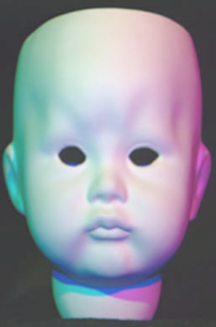


Photometric Stereo [Woodham1980]
Single shot possible assuming constant chromaticity.

Slide 6
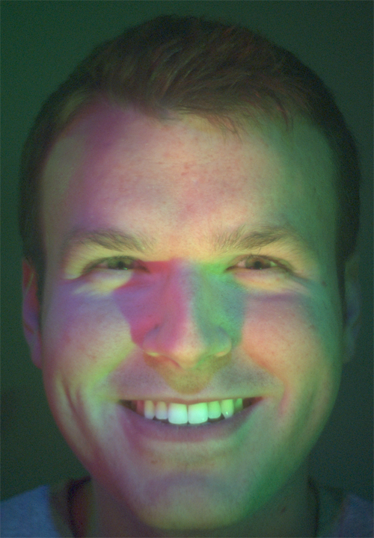
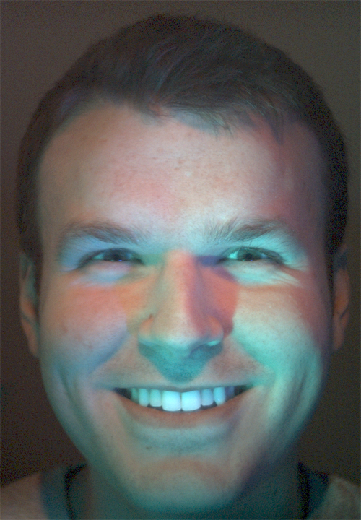
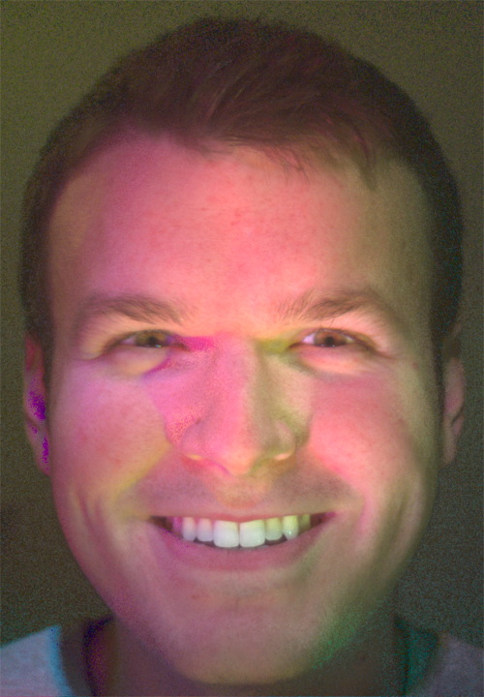
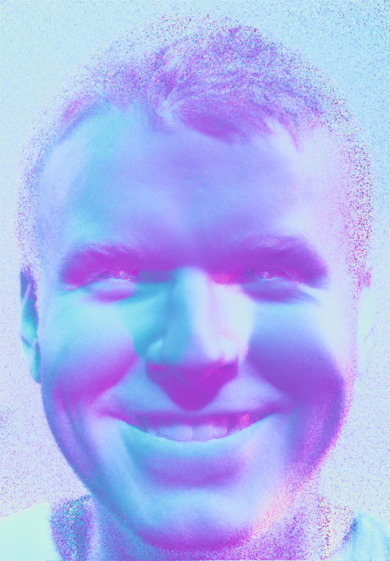
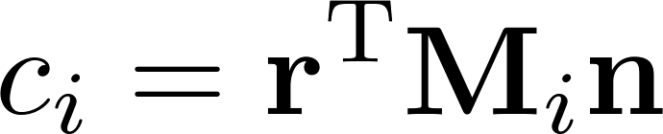
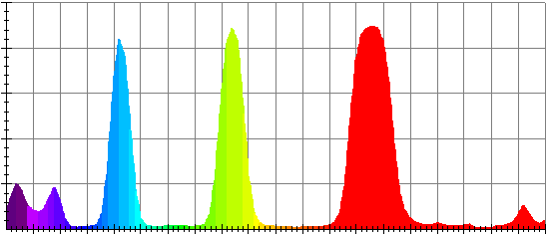
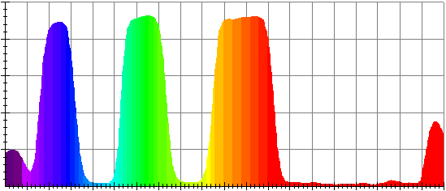
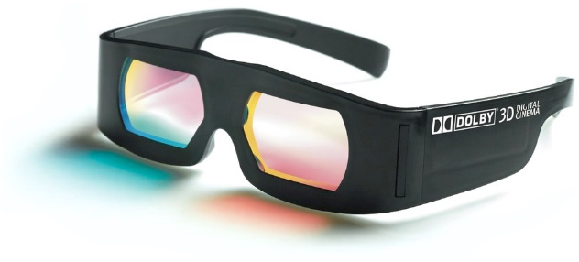
Spectral Multiplexing [Fyffe2011]
Compute color and normal from 6-channel photograph.
color
normal

Slide 7
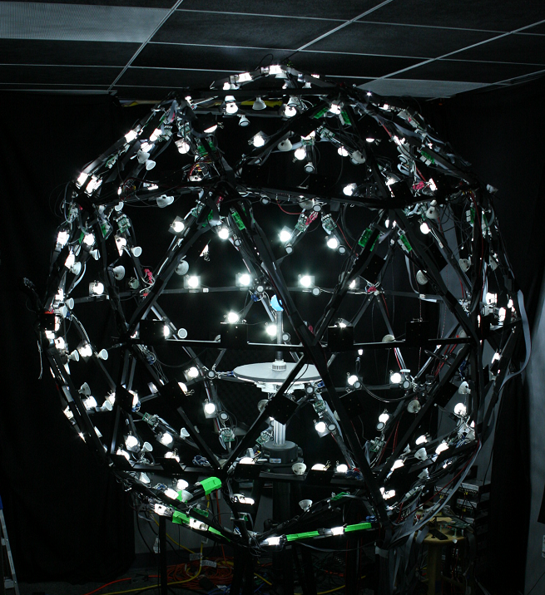
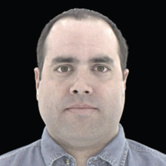
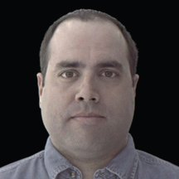
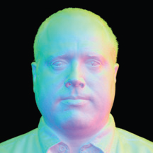


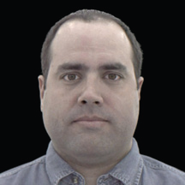
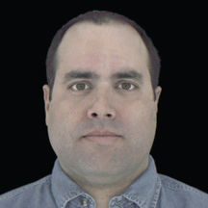
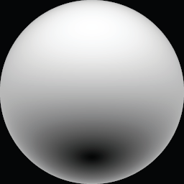

Gradient Illumination [Ma2007][Ghosh 2011]
Light Stage
gradient photographs
surface normals

Slide 8
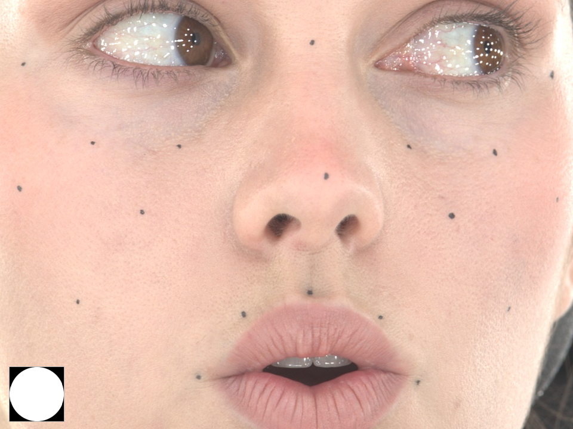
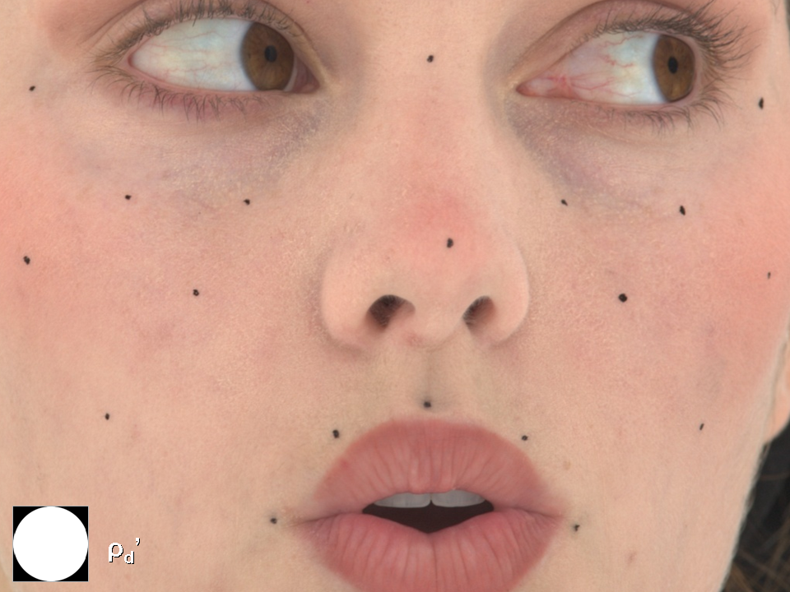
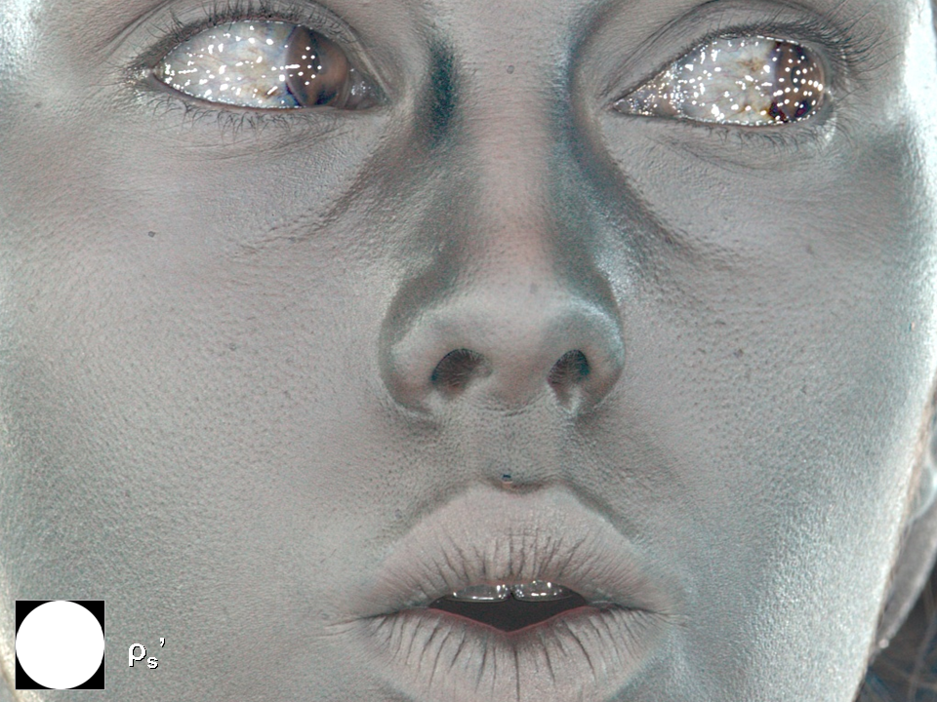
Polarization Separation [Ma2007][Ghosh 2011]
parallel polarized
cross polarized
difference

Slide 9
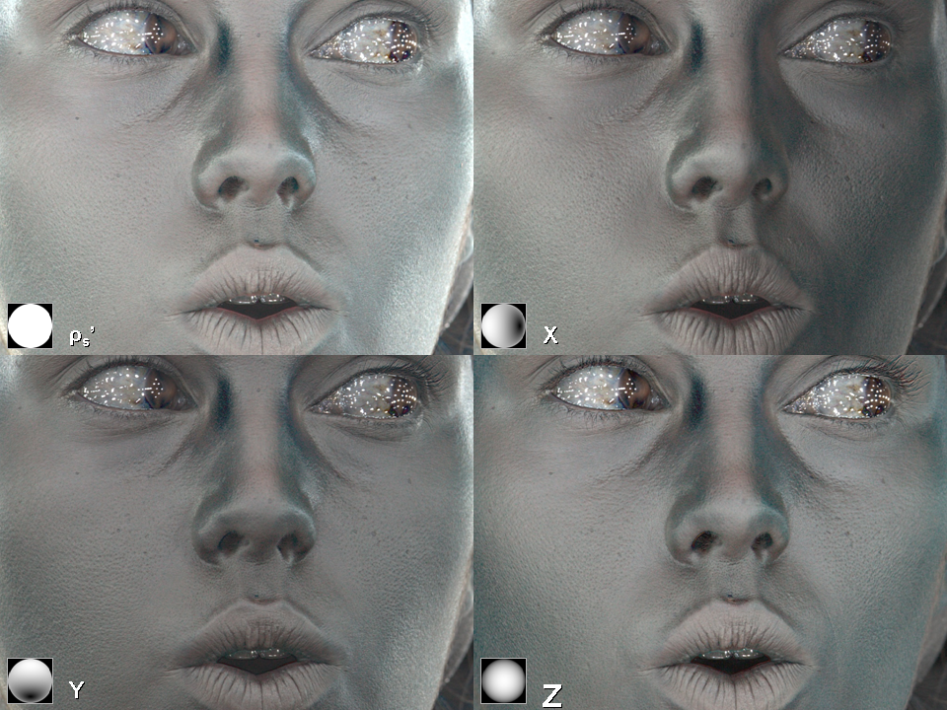
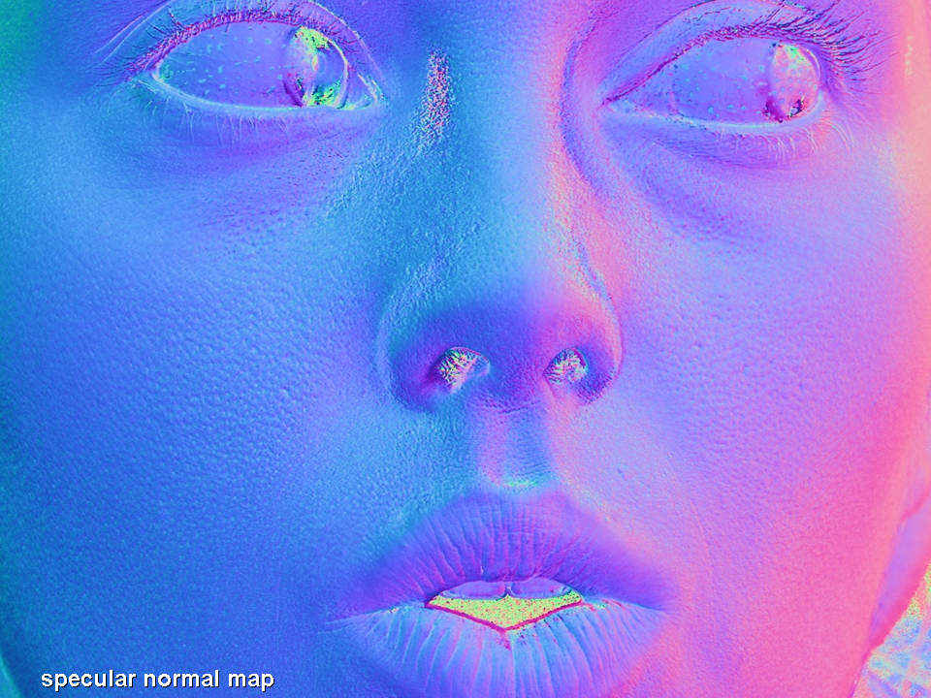
Polarized Gradient Illumination [Ma2007][Ghosh 2011]
polarization separated gradients
specular surface normal

Slide 10

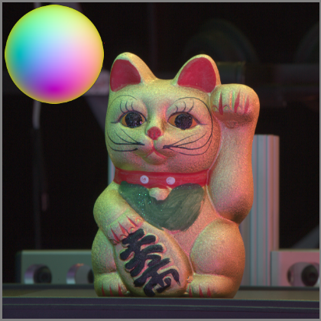
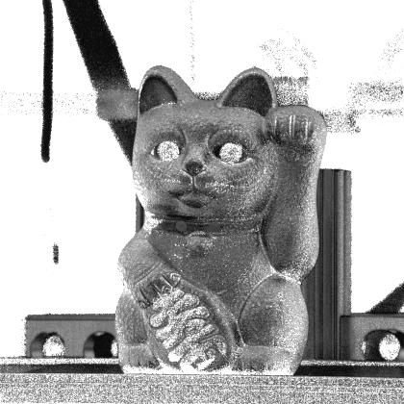

Color Gradients [Fyffe2012]
full white
color gradient
cosine exponent
cosine lobe axis

Slide 11
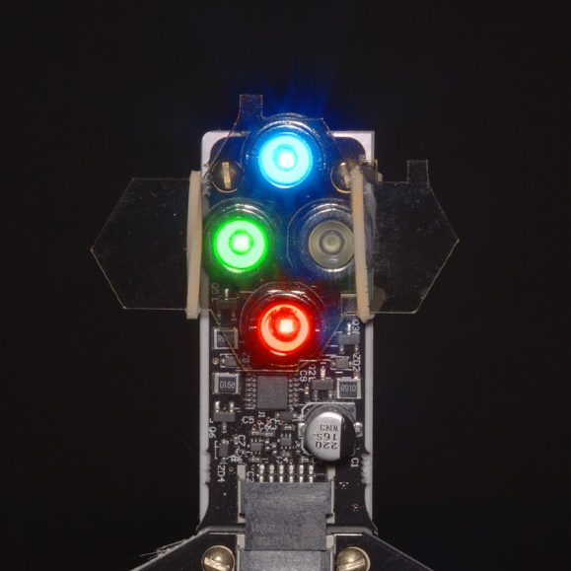
Idea: Simultaneous Polarized Color Gradients
Illuminate subject with a color gradient polarized horizontally and an opposite color gradient polarized vertically, at the same time.
Take a photo with a horizontally polarized camera, and a vertically polarized camera, at the same time.

Slide 12
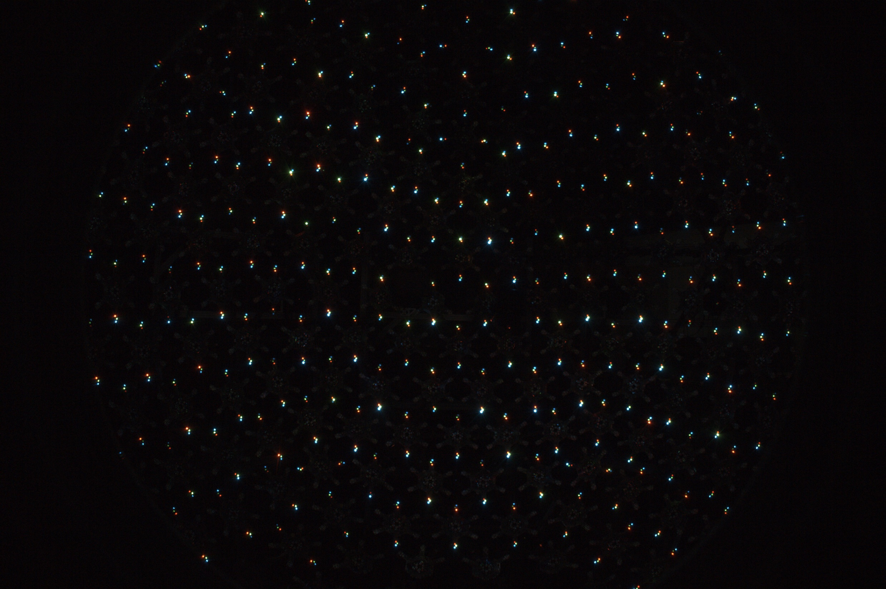

Slide 13

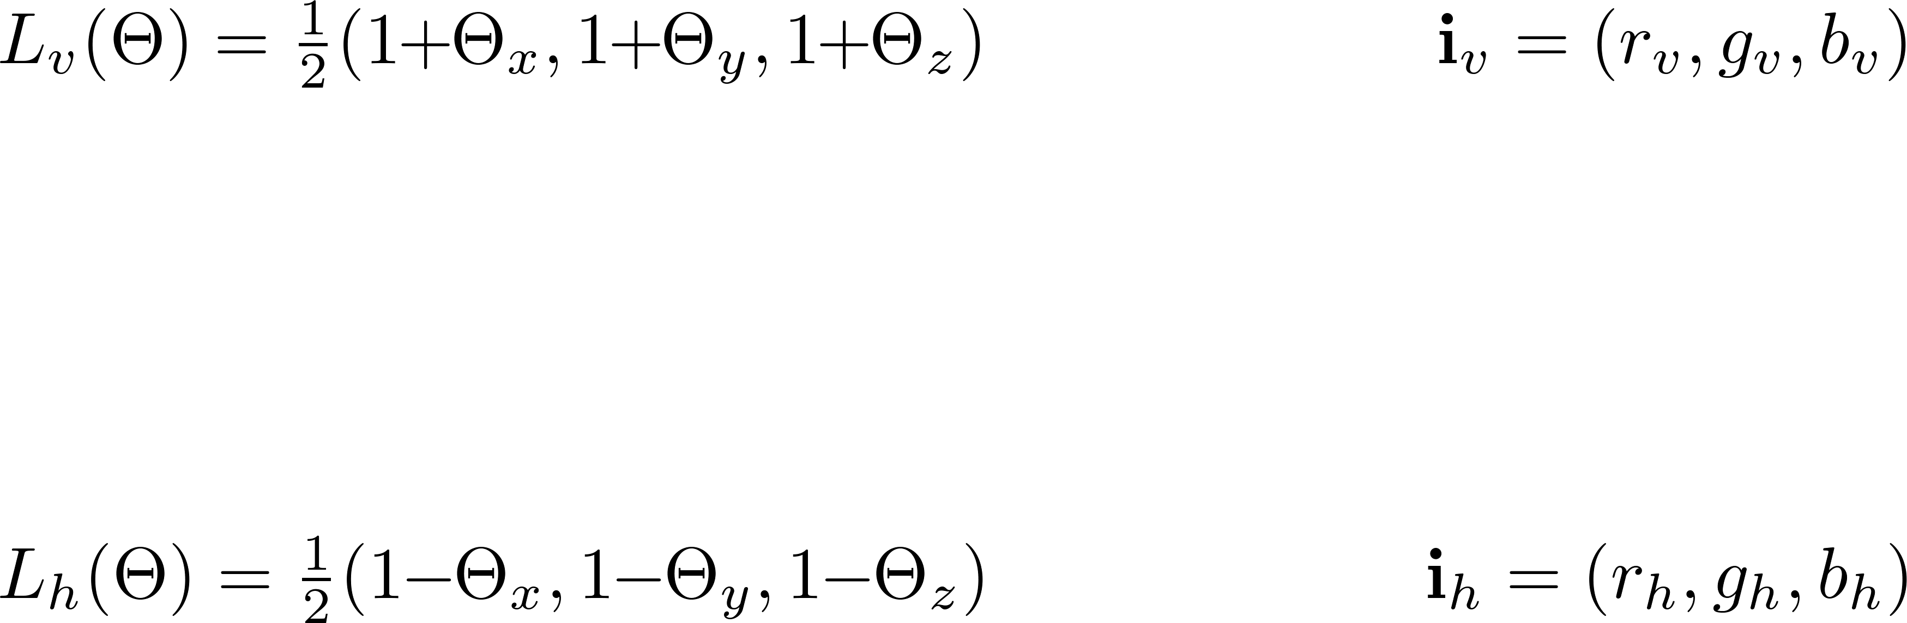
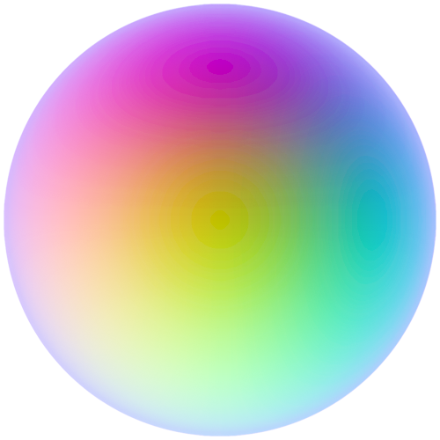
Define Lighting and Pixel Values

Slide 14
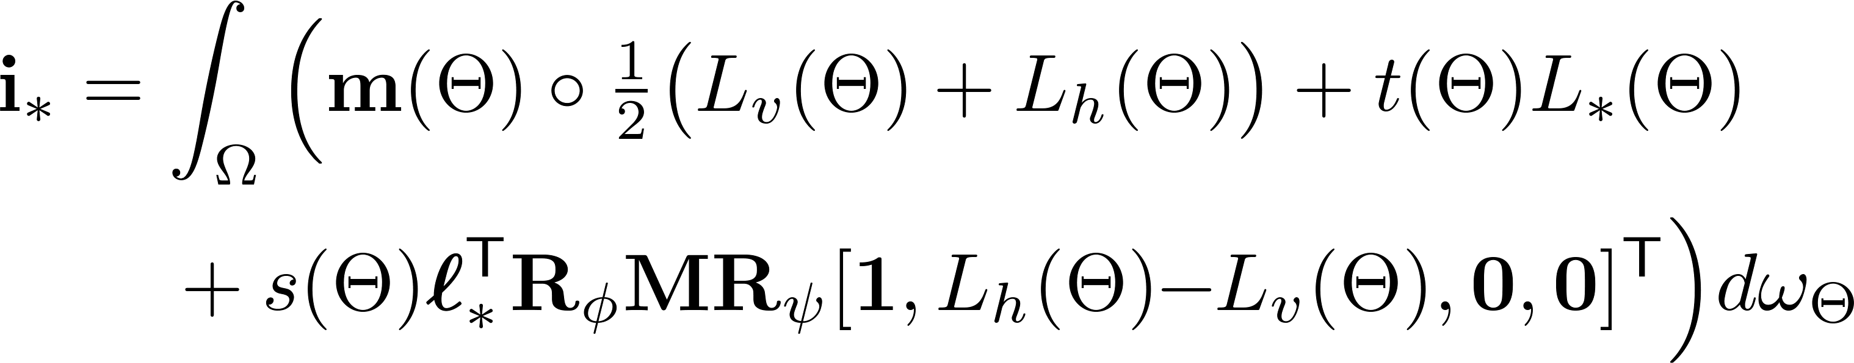


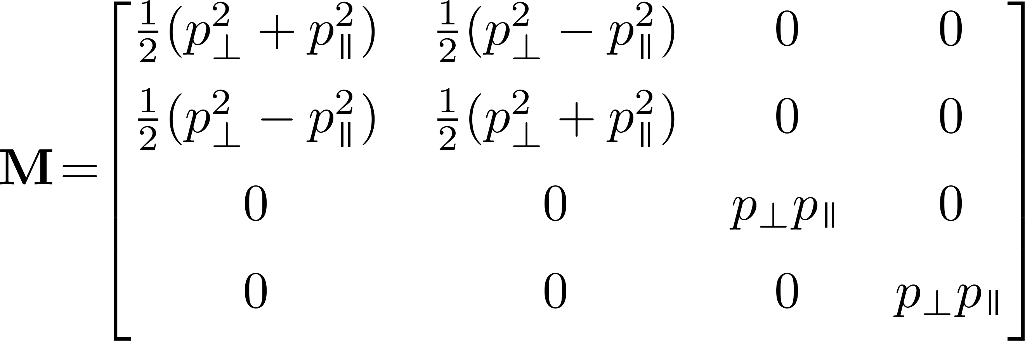
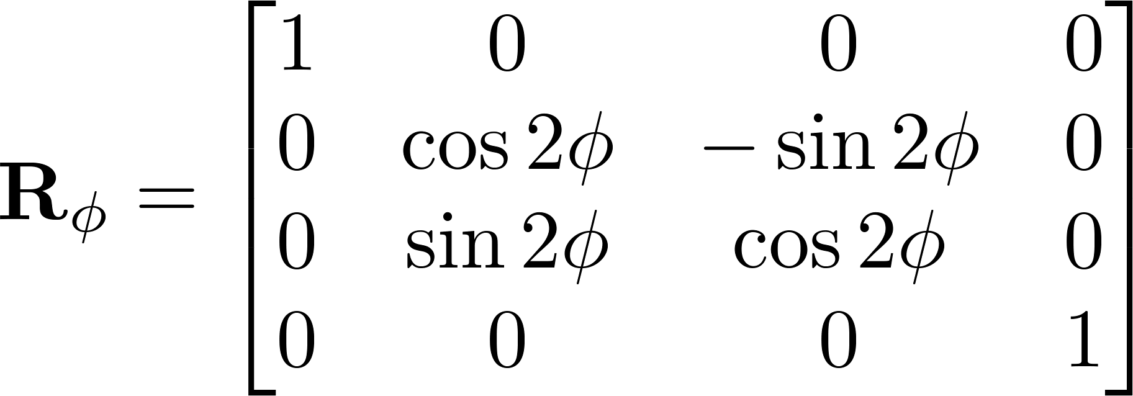
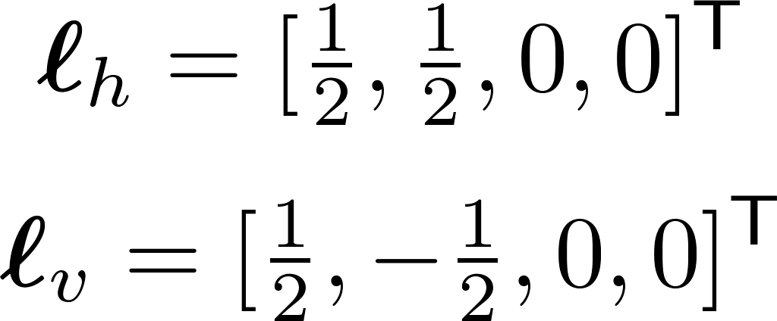
Polarization Lighting Model
multiple scattering
single scattering
or
specular
light Stokes vector
Mueller reflection
camera Stokes vector
Stokes rotation

Slide 15
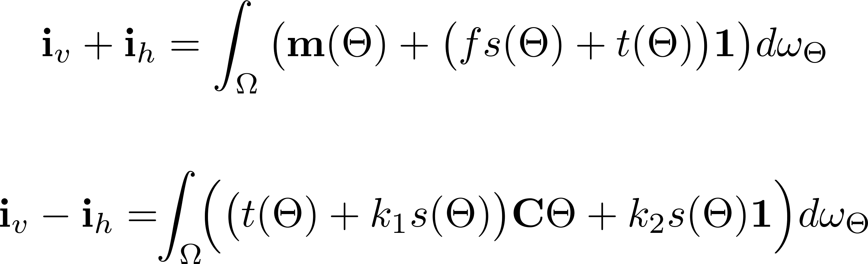
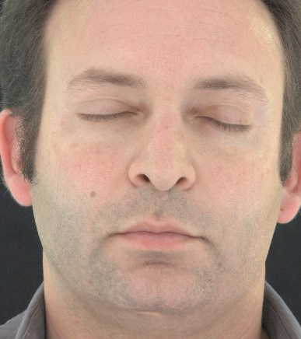
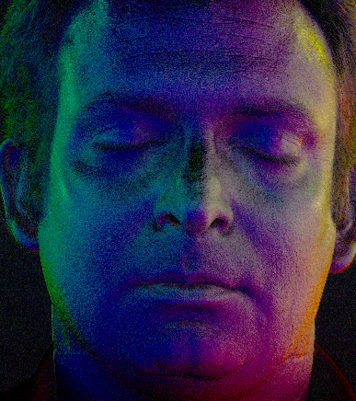
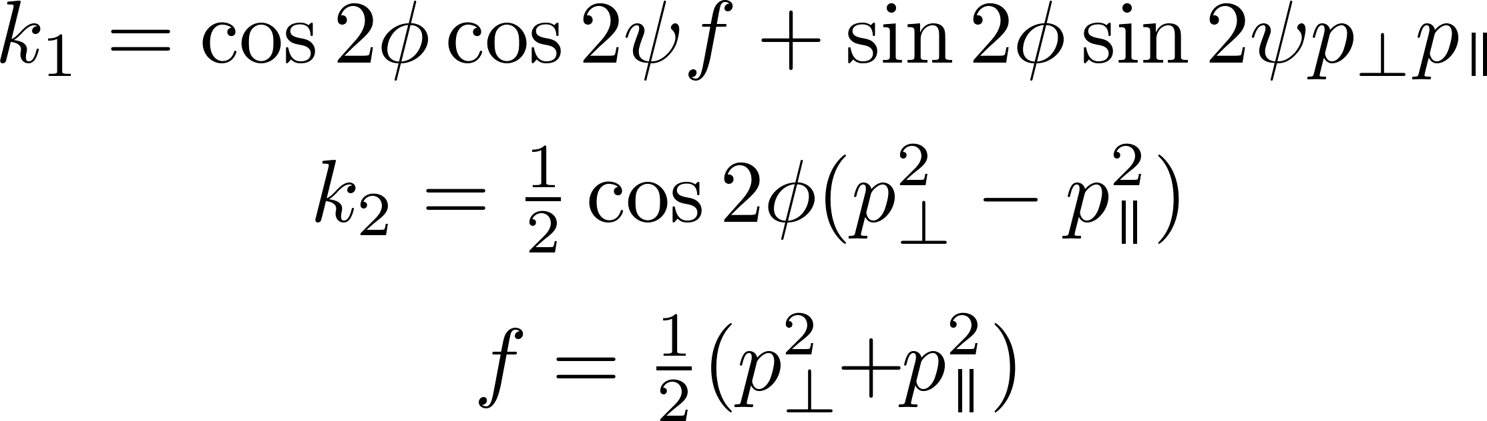


Sum and Difference

Slide 16
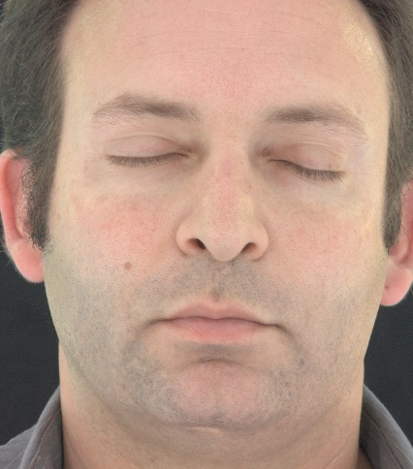



Assume Lambert and Phong

Slide 17






Some More Results
specular
diffuse
normal

Slide 18






How about Multi-View Data?
V H V
H V H

Slide 19











How about Multi-View Data?
specular diffuse normal
base mesh
refined mesh

Slide 20




Slide 21


Slide 22



Slide 23


Slide 24



Slide 25


Slide 26

specular
diffuse
normal

Slide 27

Limitations and Future Work
Very shiny surfaces break up the reflections.
Surface normals pointing mostly upward or downward don’t reconstruct well.
Maybe adding more cameras would help.
Could try alternate polarizer orientations.
Fewer photos = more sensitive to noise.

Slide 28
Conclusions
First method for single-shot capture of geometry, diffuse albedo, specular albedo, and surface normal.
Single-view or multi-view flavors, using polarizing beam splitter or polarizing filters.
Applicable to dynamic scenes.

Slide 29
Acknowledgements
Ari Shapiro
Maria Mikhisor
Antionne Scott
Shanhe Wang
Koki Nagano
Xueming Yu
Jay Busch
Kathleen Haase
Bill Swartout
Cheryl Birch
Randall Hill
Randolph Hall
Funded in part by the U.S. Army Research Laboratory’s Army Research Office.

Slide 31




Surface Normal Error - Synthetic
°
front
30° clockwise
60° clockwise
°

Slide 32









Comparison to [Ghosh2011]
[Ghosh2011]
proposed
photo 1
photo 2
specular
diffuse
normal

